Slide 1
fire extinguisher training
Presented by: Hanover Area Fire & Rescue

Slide 2
Objectives
Learn and understand the procedures to follow if there is a fire.
Learn and understand how to use a fire extinguisher.

Slide 3
Facility procedures
In case of Fire:
Control the fire if it is reasonably safe to do so.
Contact a supervisor / emergency coordinator immediately

Slide 4
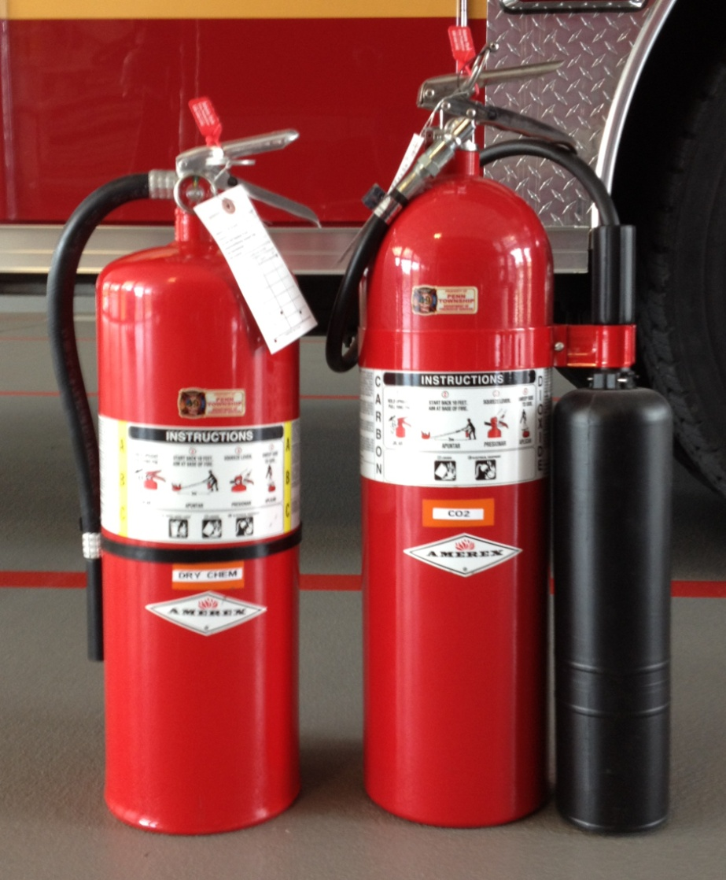
Fire Extinguishers

Slide 5
Should you fight the fire?
Have you read the instructions and are you familiar with fire extinguisher use prior to the fire.
If not leave the building immediately.
Make sure the fire is contained to a small area and not spreading.
As a general rule of thumb if the fire is larger than your average garbage can it is probably too large to fight with a portable fire extinguisher. It is reckless and dangerous to fight a fire larger than this. Leave the building immediately!

Slide 6
Before you Begin to Fight the Fire…
Make sure everyone has left or is leaving the building.
Follow your preplanned evacuation plan if you have one.
Make sure that someone has called 911 to notify the fire department.
The fire department should be notified of all fires even if you think you have extinguished the fire.
Be sure that you have an unobstructed escape route to which the fire will not spread.
The smoke from the fire combined with the cloud of extinguishing agent that will result from the discharging of the extinguisher will make it difficult to see.
Be sure that you have the proper extinguisher for the material that is burning.
Using the improper type of extinguisher could cause the fire to intensify and grow in size.

Slide 7
Types of Fire Extinguishers

Slide 8
Class A
Class “A” extinguishers will put out fires in ordinary combustibles, such as wood and paper. The numerical rating for this class of fire extinguisher holds the amount of fire it will extinguish.

Slide 9
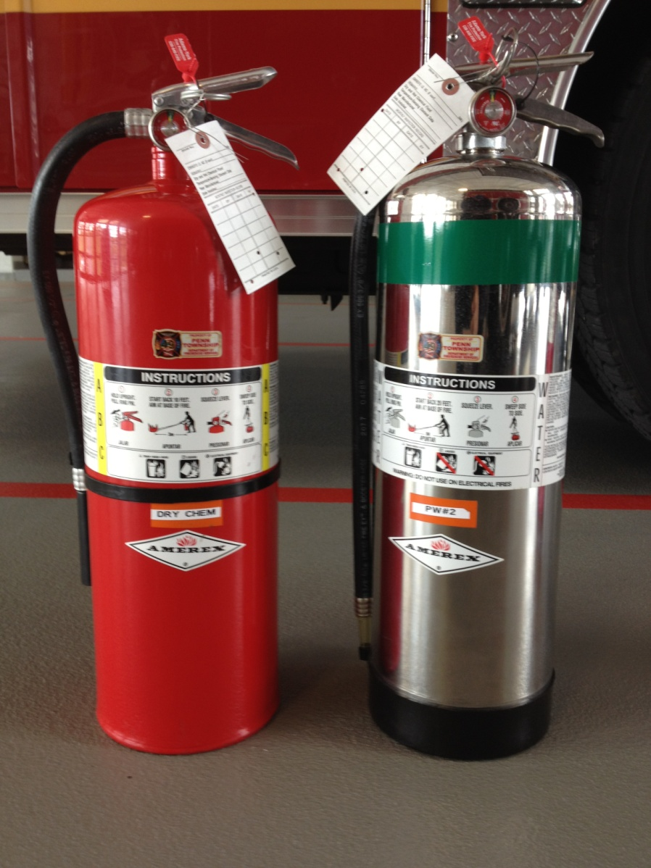
Class A

Slide 10
Class B
Class “B” extinguishers should be used on fires involving flammable liquids, such as gasoline or oil. The numerical rating for this class of fire extinguisher states the approximate number of square feet of flammable liquid fire that a non-expert user can expect to extinguish.

Slide 11
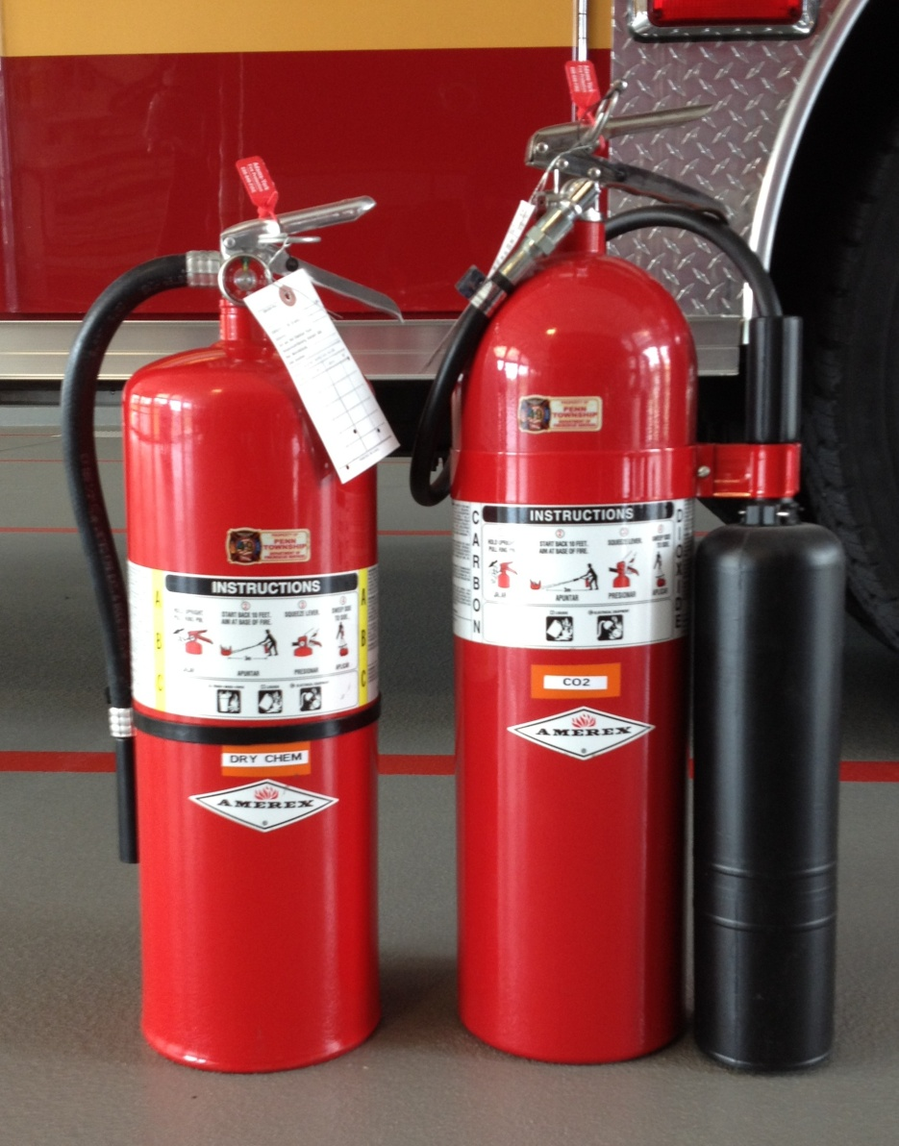
Class B

Slide 12
Class C
Class “C” extinguishers are suitable for use on electrically energized fires. This class of fire extinguisher does not have a numerical rating. The presence of the letter “C” indicates that the extinguishing agent is non-conductive.

Slide 13
Class C

Slide 14
Class D
Class “D” extinguishers are designed for use on flammable metal fires and are often specific for the type of metal in question. There is no picture designator for Class D extinguishers. These extinguishers generally have no rating nor are they given a multi-purpose rating for use on other type fires.

Slide 15
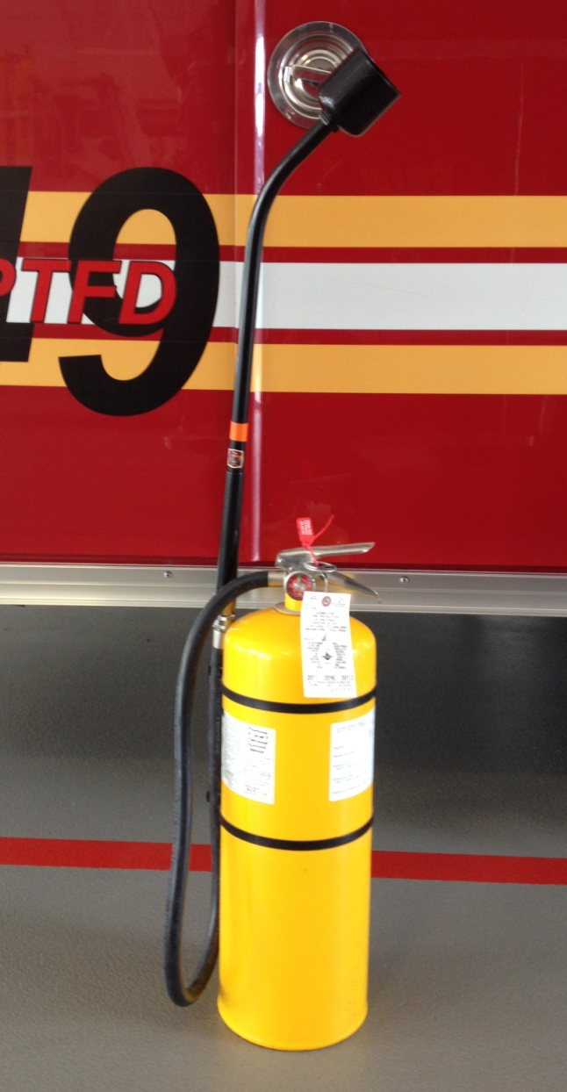
Class D

Slide 16
Class K
Class 'K' extinguishers are specifically designed to supplement fire suppression systems in kitchens. These extinguishers are designed for cooking oil, fat, and grease fires.
K

Slide 17
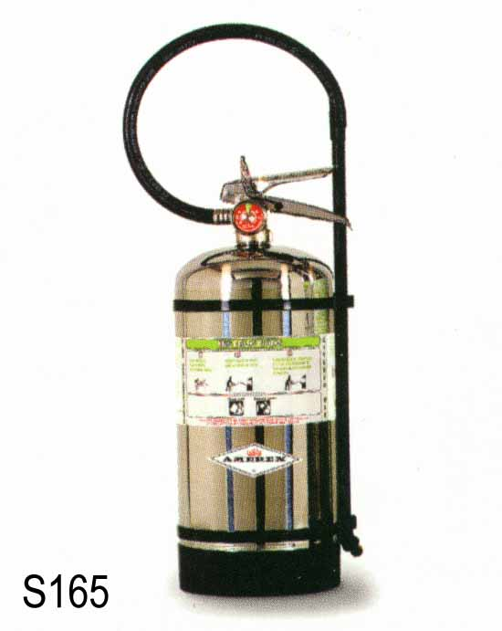
Class K

Slide 18
Multi-Class Ratings
Many Extinguishers available today can be used on different types of fires and will be labeled with more than one designator, e.g. A-B, B-C, and A-B-C. If you have multi-use extinguishers be sure they are properly labeled.

Slide 19
Multi-Class Ratings

Slide 20
Fire Extinguisher Use

Slide 21
Remember :
Keep your back to an exit
Test your extinguisher before approaching
Begin dispensing (6’) six to (8’) eight feet away from the fire.
Follow the four step PASS procedure.
If the fire does not go out leave the area immediately.

Slide 22
What is the PASS Procedure?
PASS is an acronym used to make it easier for you to remember how to use a fire extinguisher.

Slide 23
(P) Pull the Pin
This unlocks the operating lever and allows you to discharge the extinguisher
Some extinguishers have other seals or tamper indicators that need to be removed before you can pull the pin.

Slide 24
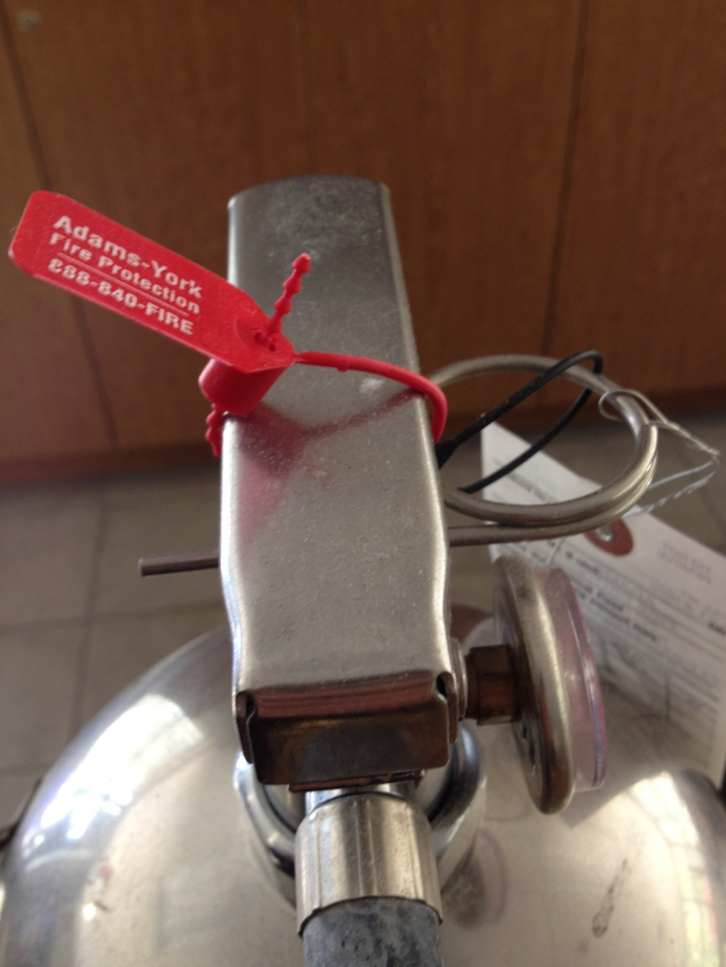
(P) Pull the Pin

Slide 25
(A) Aim Low
Point the extinguisher nozzle or hose at the base of the fire.
Aim at the lowest level of the orange / red portion of the flame. Not at the smoke.

Slide 26
(S) Squeeze the Handle
This discharges the extinguishing agent.
Be sure to depress the lever fully
Releasing the handle will stop the discharge

Slide 27
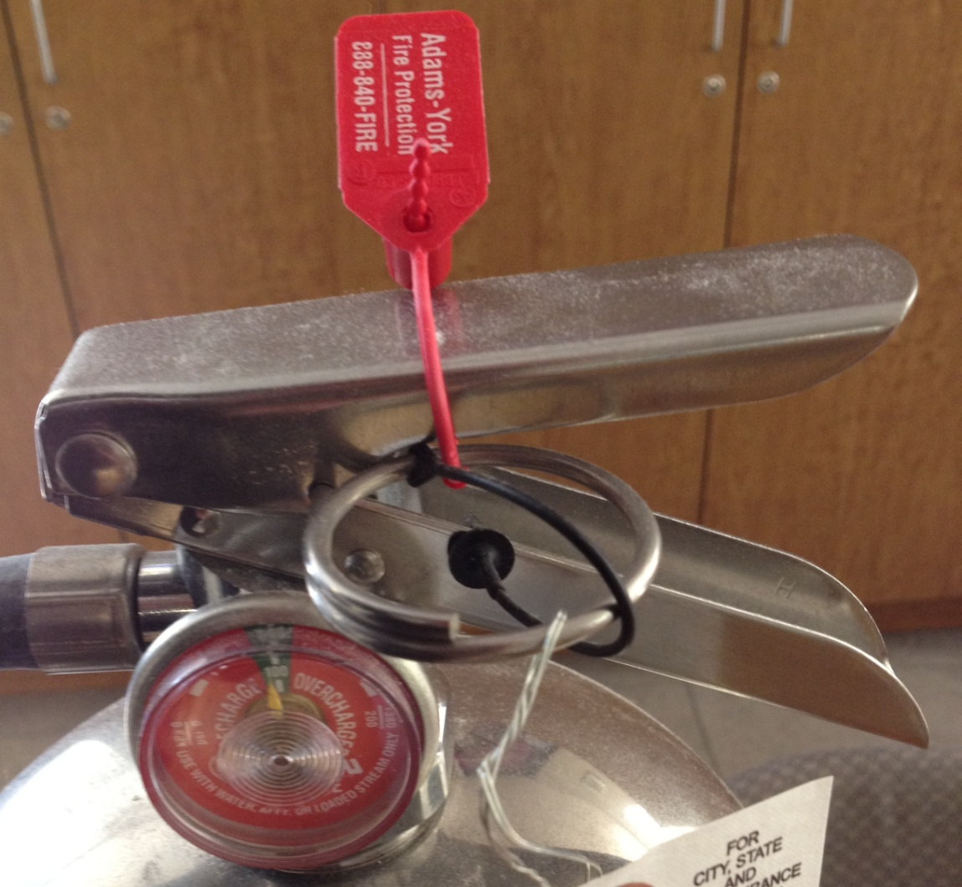
(S) Squeeze the Handle

Slide 28
(S) Sweep Side to Side
Moving carefully towards the fire, keep the extinguisher aimed at the base of the fire and sweeping left to right until the flames appear to go out.

Slide 29
Is the Fire Out?
Once the fire goes out slowly back away from the area, never turning your back on the area.
If the fire re-ignites, repeat the process.
Continue to do this until the fire stays out or you run out of extinguishing agent.
If the fire does not go out or will not stay out leave the area immediately.

Slide 30
Notify the Fire Department
The Fire Department should be notified of all fires even if you think you have them out.
Fire or hot smoldering material could be hidden within walls or other concealed areas of your facility.

Slide 31
Questions on Fire Extinguisher Use?

Slide 32
Fire prevention is the best extinguisher!
A fire that never starts never needs put out !

